Slide 1





Aircraft Delay Prediction Tool Using Machine Learning
Pooja .G.H
Megha .C
Shilpa.C
Nisha.Asture
Khushi.C
Sarthak Narnor
Faculty Of Engineering And Technology(ex-women)

Slide 2

Project Outline
Problem Statement and Objectives
Project Overview – Introduction
End Users
Wow Factor in Project
Result/outcomes
Conclusion
Future Perspective
Reference (Datalink, Github, Anyother websites)

Slide 3

Problem Statement and Objectives:
Problem Statement:
Flight delays are a common problem in the aviation industry and can cause inconvenience to passengers and financial loss to airlines. Delays occur due to factors like weather conditions, air traffic congestion, and operational issues. It is difficult to predict these delays accurately using traditional methods. Therefore, a Machine Learning based system is needed to analyze historical flight data and predict aircraft delays in advance. ✈️
Objectives :
To analyze historical flight data.
To preprocess and clean the dataset.
To develop a Machine Learning model.
To train and test the model.
To evaluate the model performance.
To create a simple prediction tool .
To help airlines and airports make better operational decisions.

Slide 4
Project Overview – Introduction:
Air transportation is an important mode of travel that connects people and businesses across the world. However, flight delays are a common problem in the aviation industry and can occur due to factors such as weather conditions, air traffic congestion, technical issues, and airport operations. These delays cause inconvenience to passengers, disturb travel schedules, and result in financial losses for airlines. With the growth of data and technology, Machine Learning can be used to analyze large amounts of historical flight data and identify patterns related to delays. Machine learning algorithms can learn from past data and help predict whether a flight is likely to be delayed or not. This project, Aircraft Delay Prediction Tool Using Machine Learning, aims to develop a predictive system that analyzes flight information and forecasts possible delays. By predicting delays in advance, airlines and airport authorities can improve planning, manage resources better, and reduce the impact of delays on passengers, making air travel more efficient and reliable. ✈️

Slide 5

End Users :
Airlines
Airport Authorities
Air Traffic Control (ATC)
Passengers / Travelers

Slide 6



Wow Factors in Project :
Uses Machine Learning to predict flight delays using real historical data.
Early Delay Prediction helps airlines and passengers plan better.
Data-Driven Decision Making for improving airline scheduling and airport operations.
Improves Passenger Experience by giving advance information about delays.
Efficient Resource Management for airports and airlines.
Visualization of Data using graphs and analysis to understand delay patterns. ✈️

Slide 7

Technology Stack:
Programming Language: Python
Libraries: Pandas, NumPy, Scikit-learn, Matplotlib, Seaborn
Machine Learning Algorithms: Random Forest, Support Vector Machine (SVM)
Development Environment: Visual Studio Code or Jupyter Notebook
Dataset Format: CSV (Flight Delay Dataset)
Model Saving: Joblib or Pickle

Slide 8
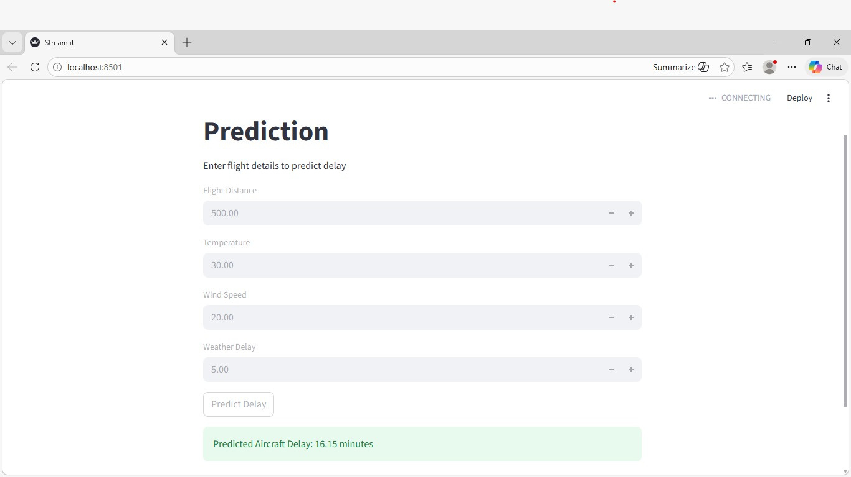
Result/Outcomes

Slide 9
Conclusion:
The Aircraft Delay Prediction Tool using Machine Learning helps in predicting possible flight delays by analyzing historical flight data. In this project, machine learning algorithms are used to identify patterns and factors that cause delays. The system can provide early predictions, which helps airlines and airport authorities make better decisions. It can also help passengers plan their travel more efficiently. By using data analysis and machine learning techniques, the accuracy of delay prediction can be improved. Overall, this project demonstrates how technology can be used to reduce the impact of flight delays and improve the efficiency of air transportation. ✈️

Slide 10
Future Perspective :
In the future, the Aircraft Delay Prediction Tool can be improved by using larger and real-time flight datasets to increase prediction accuracy. Advanced Machine Learning and Deep Learning algorithms can also be applied for better performance. The system can be integrated with airline and airport management systems to provide real-time delay updates. A web or mobile application can also be developed so that passengers can easily check delay predictions. Additionally, the model can include more factors like live weather data and air traffic information to make the prediction system more efficient and reliable.

Slide 11
Reference
https://scikit-learn.org/stable/https://www.geeksforgeeks.org/machine-learning/

Slide 12
Thank You

